Slide 1

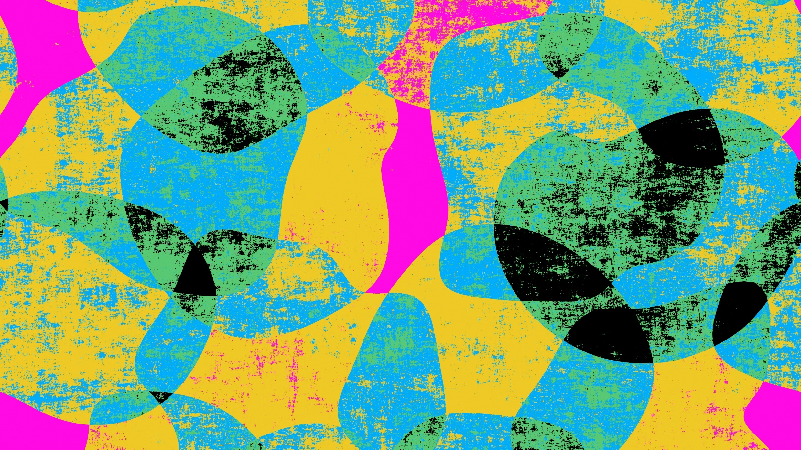
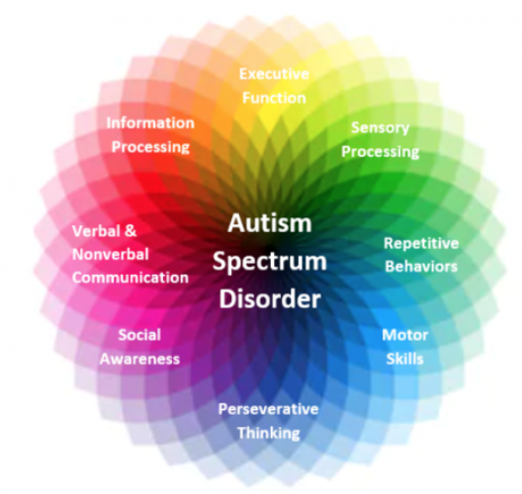
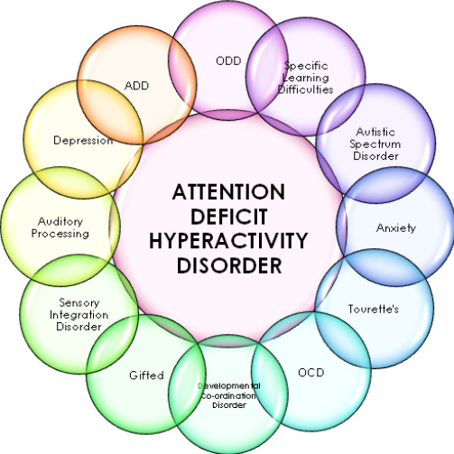
Coloring images with GAN
Padma M Dhakappa

Slide 2
Research Papers
The Effect of Coloured Images on Children with Autism
Do colour images influence Attention span in children with ADHD
Image Colorization using Convolutional Autoencoders and Generative Adversarial Networks

Slide 3
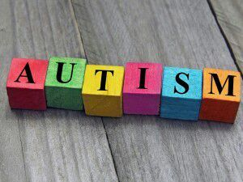
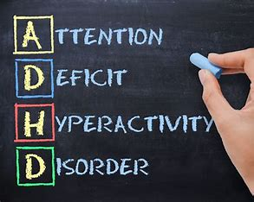
Sensory Integration and visual discrimination: Colorized images provide multisensory stimulation that can help integrate sensory information and promote sensory regulation, making learning more accessible and enjoyable help them differentiate patterns better.
Predictability and Consistency: Colorization can provide predictability and consistency in educational materials, which can be reassuring for children with autism who thrive on routine and structure. Consistent use of color coding and visual elements can help create a familiar learning environment and reduce anxiety associated with novel or unfamiliar stimuli.
Attention and Engagement: Colorized images tend to capture attention more effectively than black and white images due to the increased visual stimulation they provide. Research indicates that the human brain is naturally drawn to color and tends to prioritize colorful stimuli over monochromatic ones. As a result, colorized images can enhance engagement and sustain attention during learning activities.
Emotional Response and Motivation: Color has the potential to evoke emotional responses and influence mood, which can impact motivation and learning outcomes. Bright and vibrant colors are often associated with positive emotion

Slide 4
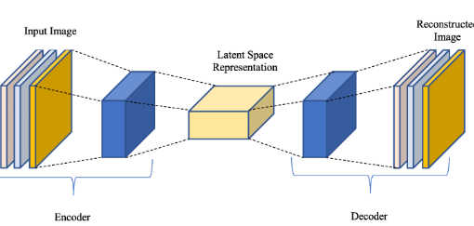
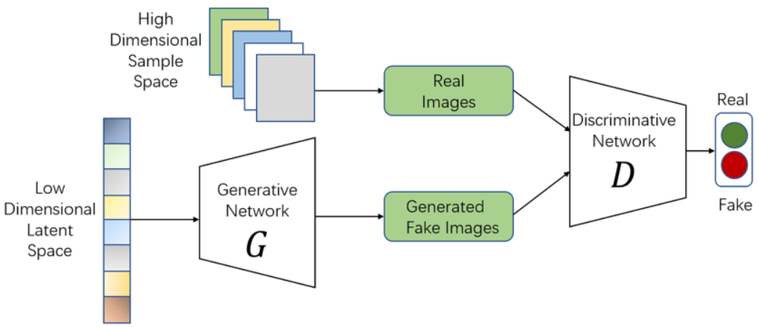
Colouring Images

Slide 5
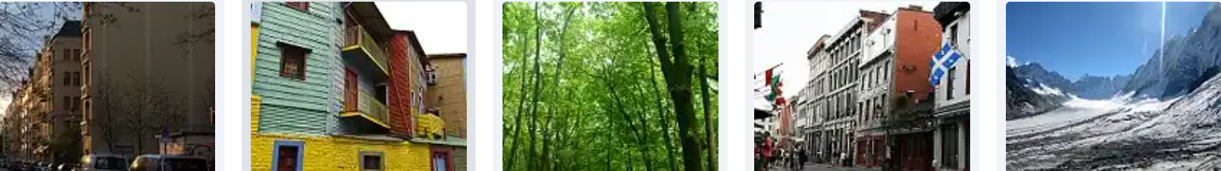
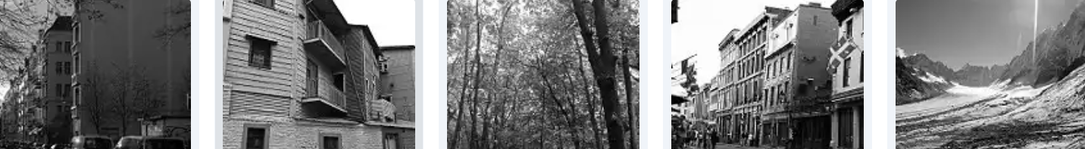
Landscape
Dataset
7129 coloured
and
7129 gray
Images

Slide 6
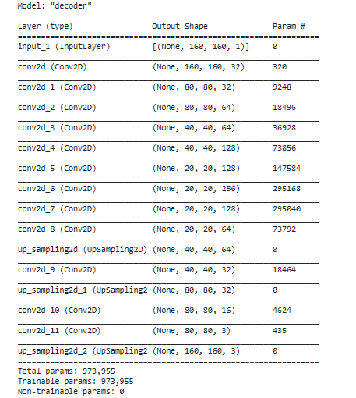
Using Autoencoder

Slide 7
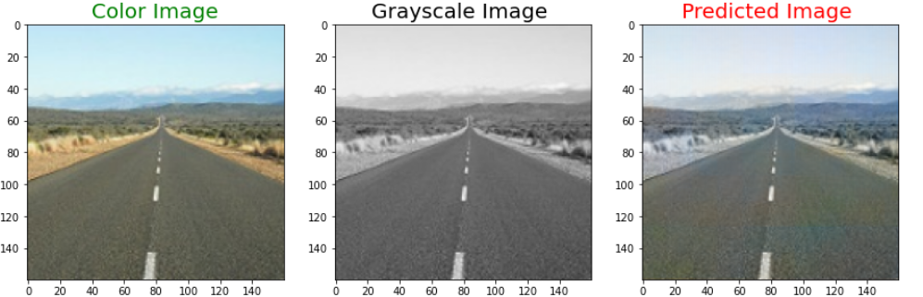
Autoencoder:
Sequential Auto Encoder with 2D Convolution
Loss - Mean Square Error
Validation Loss : 0.09
Results

Slide 8
Image Colorization using GANs
This presentation introduces a project focused on image colorization using Generative Adversarial Networks (GANs).
The model architecture and the discriminator are key components of this project.
We have included results for human evaluation

Slide 9
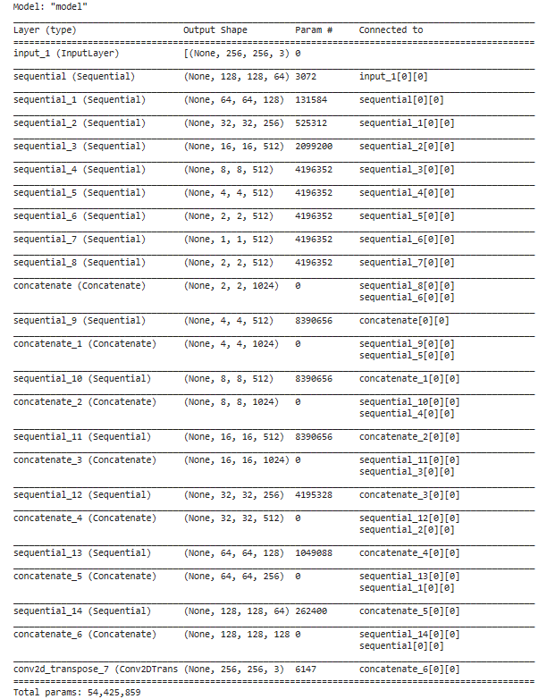
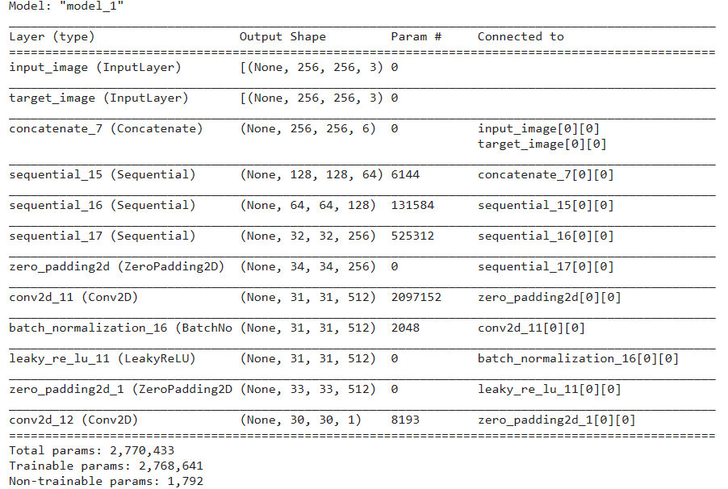
Using GAN
Generator
Discriminator

Slide 10
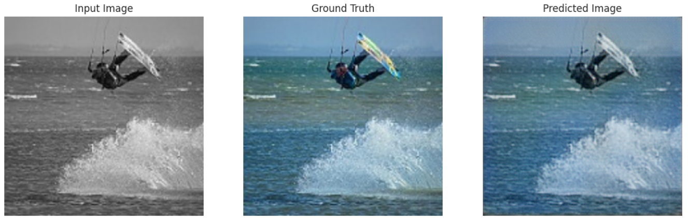
Results
GAN:
Standard GAN

Slide 11
Autoencoder:
Results
GAN:

Slide 12
Generator Description
The model used in this project is based on the U-Net architecture, a popular CNN structure for image-to-image translation tasks.
U-Net consists of an encoder-decoder structure with skip connections, allowing it to preserve spatial information and generate high-quality colorized images from grayscale inputs (L channel).
Key Points:
Loss Functions:
The U-Net generator is trained using a combination of adversarial loss (GAN loss) and L1 loss. The adversarial loss guides the generator to produce realistic colorized images, while the L1 loss ensures pixel-wise accuracy between the generated colorized images and the ground truth.
Training Strategy:
The model is trained using an adversarial training strategy where the generator competes against the discriminator. This adversarial setup helps in improving the quality and realism of the colorized images produced by the generator.
Optimization Technique:
The training process involves optimizing the model's parameters using the Adam optimizer, a popular choice for training deep learning models. Adam adapts the learning rate for each parameter individually, leading to faster convergence and improved performance.
Data Augmentation:
To enhance the model's robustness and generalization capabilities, data augmentation techniques such as random horizontal flipping are applied during training. This helps in increasing the diversity of the training data and reducing overfitting.

Slide 13
Discriminator Description
The discriminator in this project is a PatchDiscriminator, which is designed to distinguish between real color images and fake color images generated by the U-Net generator.
It uses convolutional layers with downsampling to analyze image patches and provide feedback to the generator during adversarial training.
Key Points:
Patch-Based Analysis:
The PatchDiscriminator operates on image patches rather than entire images, allowing it to focus on local details and textures. This patch-based analysis improves the discriminator's ability to detect inconsistencies and artifacts in the generated colorized images.
Multi-Scale Discrimination:
To capture features at different scales, the PatchDiscriminator employs multiple convolutional layers with varying receptive fields. This multi-scale discrimination helps in effectively distinguishing between real and fake color images across different levels of detail.
Downsampling Layers:
The discriminator incorporates downsampling layers such as max-pooling or convolution with stride to reduce spatial dimensions and extract high-level features from image patches. This downsampling process enhances the discriminator's capacity to learn discriminative representations.
Adversarial Feedback:
During adversarial training, the PatchDiscriminator provides feedback to the U-Net generator by evaluating the realism of the generated colorized images. This adversarial feedback loop encourages the generator to produce more realistic and visually appealing colorizations.
Loss Function:
The discriminator is trained using a binary cross-entropy loss function, which penalizes incorrect classifications of real and fake color images. This loss function guides the discriminator to become more accurate in distinguishing between real and generated images.

Slide 14
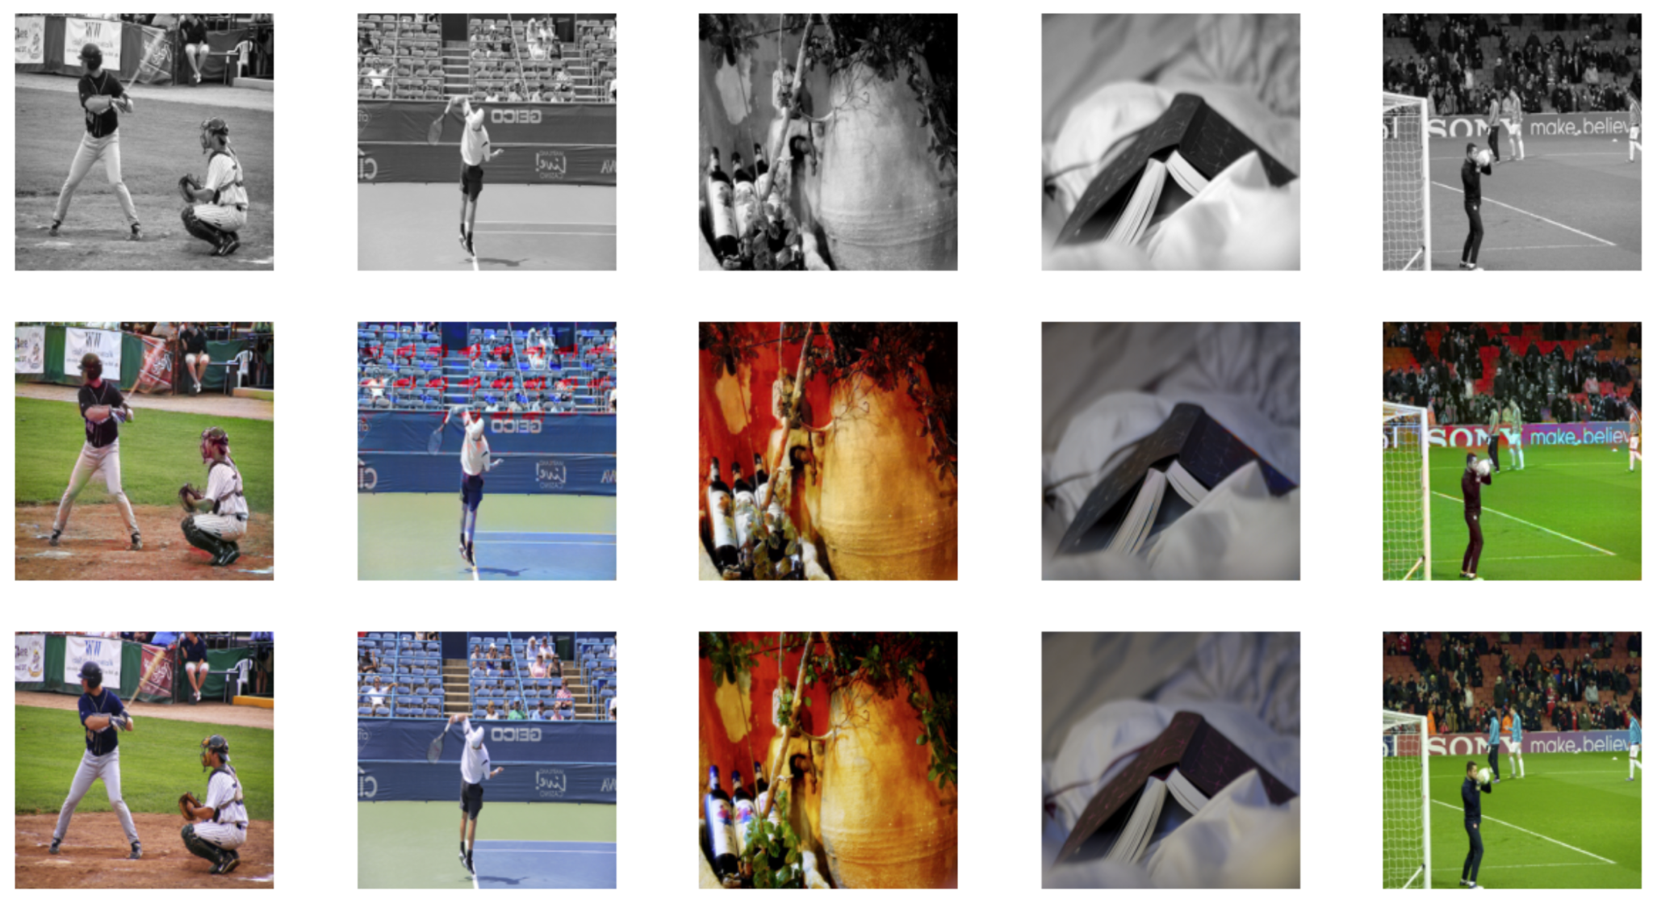
Results
Input Images
Output Images
Ground Truth

Slide 15
Thank You

